Slide 1
Many-core programming, a practical approach.
COMPAS conference
July 5-8 2016
Pierre Bomel
Université de Bretagne Sud
Lab-STICC
Lorient, France
http://www.univ-ubs.fr/
http://www.lab-sticc.fr/

Slide 2
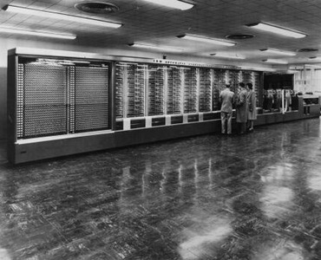
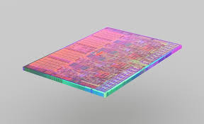
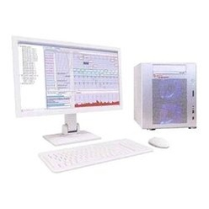
Plan
1^{rst} day
1^{rst} hour: from the first computers to multithreading
2nd hour: software paradigms for many-cores
3rd hour: Kalray’s MPPA-256 and project presentation
2nd day
Your project with remote Kalray machines at UBS
OpenCL
OpenMP
MPI
Posix

Slide 3
Detailed plan
How to login and logout
Copy all the examples in your working directory
Make a try: compute the mean of an array with OpenMP
Exercise 1: measure the impact of the number of threads
Exercise 2: do the same again, but with Posix Threads,
and compare with OpenMP’s results.
Which one is the best ?
Detailled presentation of the software environment and tools
Exercise 3: at chip level you will now use
from 1 thread on a single cluster (1 core)
to 16 clusters of 16 threads each (256 cores)
Mini-project: find a min/max values with all the chip’s computing power
Project: estimate PI

Slide 4
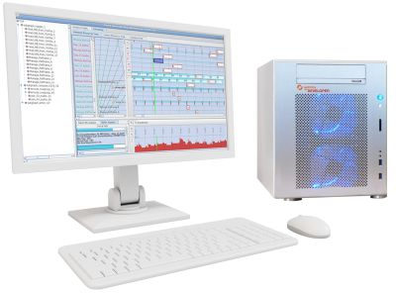
Login to a Kalray machine and work in your directory
home
accesscore
upm-madrid
Kalray-1
Kalray-2
stud<n>
Unfortunately we have only one login account on our Kalray machines.
So, each one of you, or each group, has received a (machine number, student number)
The machine number is the number of the Kalray machine you will log into.
The student number is the number of the stud directory where you will work.
i.e. (1, 3)
will allow you to log into the Kalray machine # 1
and use the stud3 directory for your tests

Slide 5
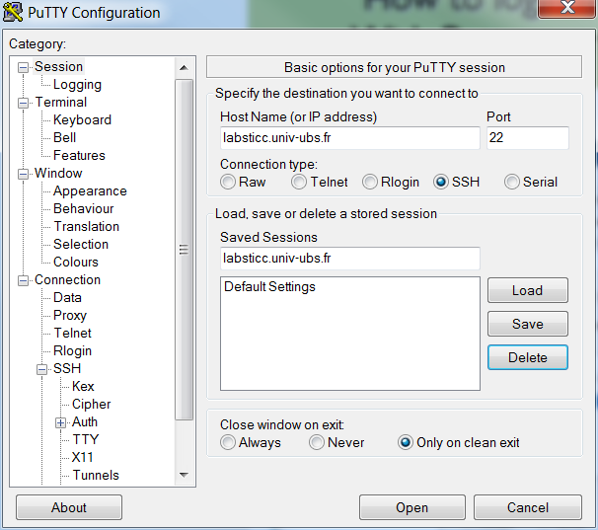
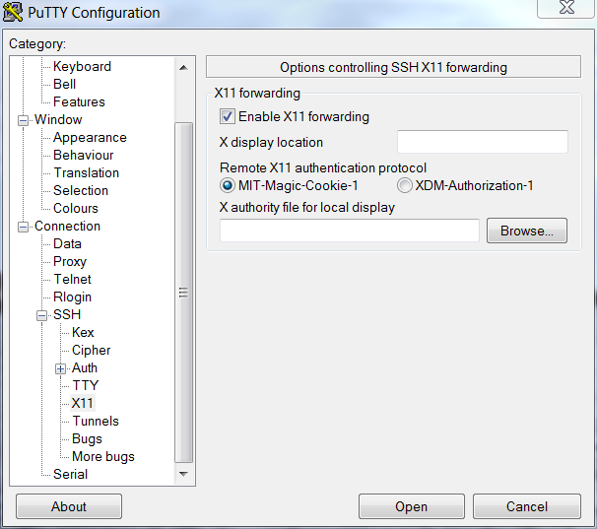
Create your Putty session
Don’t forget to click
on "Save"

Slide 6
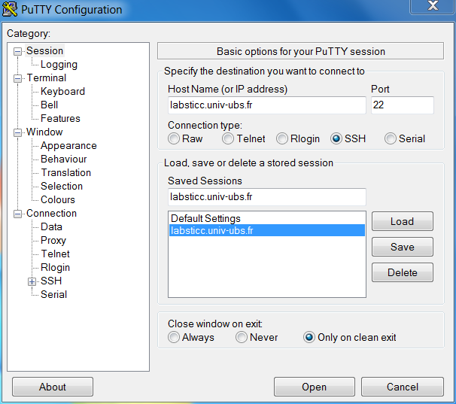
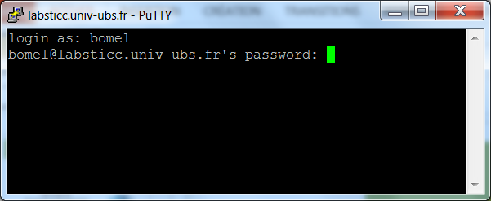
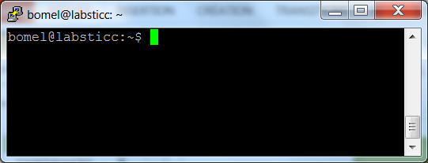
How to login from a Windows computer at UBS With Putty, user bomel, password ??????????
1
2
3
4

Slide 7
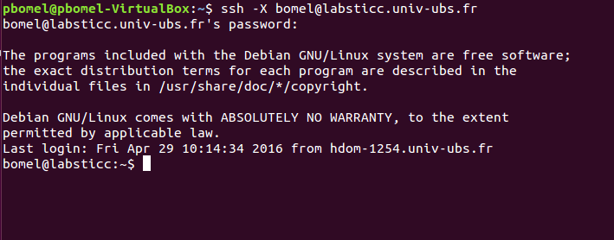
How to login from a Linux computer at UBS With ssh, user bomel, password ??????????
Don’t forget the –X or gedit will not appear
on your display when needed.

Slide 8
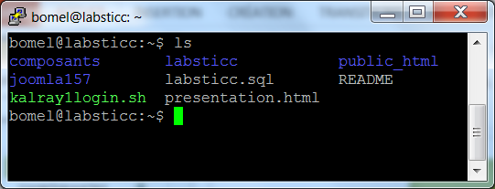
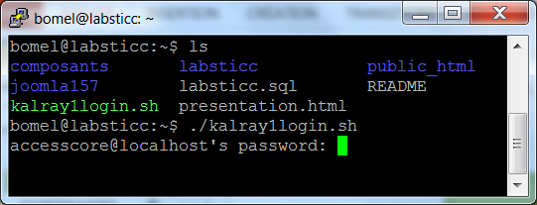
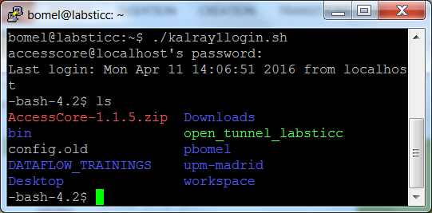
Login from Lab-STICC at UBS to a Kalray machine password ??????????
1
To login to the Kalray machine # 1, type
./kalray1login.sh
To login to the Kalray machine # 2, type
./kalray2login.sh
2
3

Slide 9
The bomel account on a Kalray machine Yes … it’s mine ☺
You will always work here
NEVER anywhere else !
Please, neither modify, nor delete, anything inside the other directories !

Slide 10
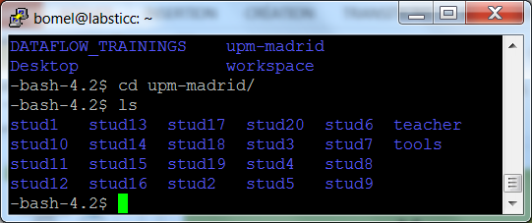
UPM’s directory
Go to the upm_madrid directory: cd upm_madrid
Type ls to see what is inside it.
There are several stud*, a teacher, and a tools directories.
(upm comes from a previous tutorial, organized at Madrid)

Slide 11
UPM’s directory
Remember, each one of you, or each group, has received a (machine number, student number)
The machine number is the number of the Kalray machine you will log into.
The student number is the number of the stud directory where you will work.
i.e. (1, 3)
will allow you to log into the Kalray machine # 1
and use the stud3 directory for your tests

Slide 12
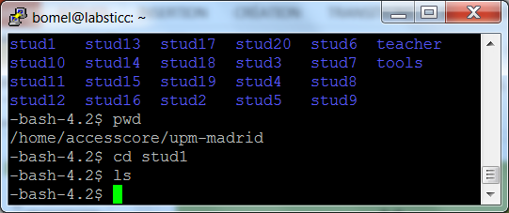
Your student directory
If you go into any stud directory, it will be empty at the start of your works.
Don’t forget to go in the good directory to avoid polluting the work of others.

Slide 13
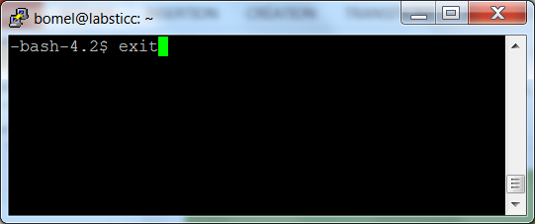
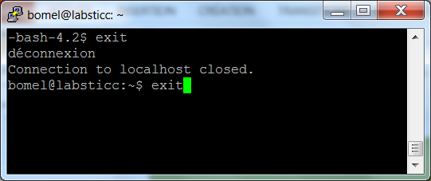
How to logout
1
To logout from the Kalray machine
type exit or CTRL-D
To logout from the labsticc machine
type exit or CTRL-D
2
Don’t forget
to always
logout !

Slide 14
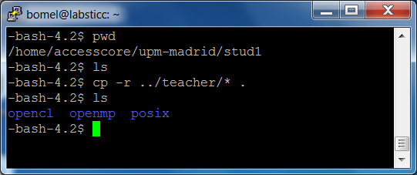
Copy the examples in your working directory (stud1 is assumed here)
You will copy all the directories from the teacher directory into yours

Slide 15
Copy the examples in your working directory But, what is inside ?
teacher
opencl
chip-level
posix
makefile
test.c
openmp
ioddr.c
makefile
mean.c
mean.h
barrier
barrier
mean
makefile
barrier.c
mean
mutex
makefile
barrier.c
mutex
test
makefile
mean.c
test
makefile
mean.c
makefile
mutex.c
makefile
test.c
makefile
mutex.c
makefile
test.c

Slide 16
Copy the examples in your working directory But, what is inside ?
Openmp/posix
barrier
mean
makefile
barrier.c
mutex
test
makefile
mean.c
makefile
mutex.c
makefile
test.c
All these examples (barrier, mean, mutex) are the same,
but expressed with openmp and Posix threads.
They show you how to write code with these two standards.
test is a systematic demo of all the directives or functions used in previous slides.

Slide 17
Copy the examples in your working directory But, what is inside ?
opencl
makefile
test.c
test is a systematic demo of all the functions used in previous slides applied to the Kalray machine.

Slide 18
Copy the examples in your working directory But, what is inside ?
chip-level
ioddr.c
makefile
mean.c
mean.h
chip-level is a demo of the computing of a mean value, with all the clusters.
It illustrates the cooperation of several clusters to produce a result.
It is based on the mean value computing programs found under openmp/mean and posix/mean.

Slide 19
Let’s make a try Let’s compute the mean of an array with OpenMP
An array T is initialized with values from 1 to N, N being the size of the array.
T
0
1
2
3
N-2
N-1
Its mean value is the sum of all the T[i], divided by N.
Its mean value is equal to ((N-1)/2)
We can compute it with one thread, or several ones.
We will always get the same value, but with different computing times.

Slide 20
Let’s make a try Let’s compute the mean of an array with OpenMP
Mean value = M is the sum of all the T[i], divided by N (1)
(1) M $=\frac{\sum_{i=0}^{N−1}{T[i]}}{N}$ If P = $\frac{N}{T}$ with T the number of threads
M = $\frac{\sum_{i=0}^{N−1}{T[i]}}{N}= \frac{\sum_{i=0}^{P.T−1}{T[i]}}{P.T}= \frac{\sum_{i=0}^{T−1}{.\sum_{j=0}^{P−1}{T[i.P+j]}} }{P.T}=\frac{\sum_{i=0}^{T−1}{.\sum_{j=0}^{P−1}{T[i.P+j]}} }{P.T}$
(2) M = $\frac{\sum_{i=0}^{T−1}{.\frac{\sum_{j=0}^{P−1}{T[i.P+j]}}{P}} }{T}$ = $\frac{\sum_{i=0}^{T−1}{.M(i)} }{T}$
M = the mean value of the mean values M(i) computed by the threads (2)
(3) It is also equal to ((N-1)/2)
We can compute it with one thread, or several ones.
We will always get the same value, but with different computing times.

Slide 21
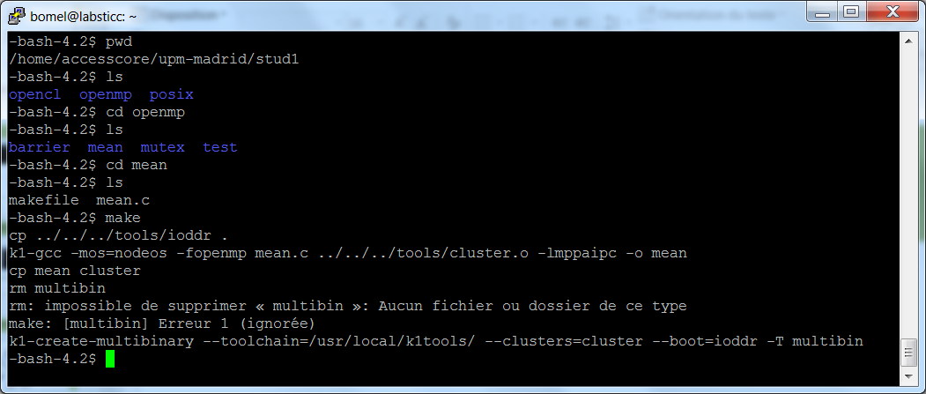
Let’s make a try Let’s compute the mean of an array with OpenMP
Build the executable files with make
You can ignore the error message, all is OK

Slide 22
Let’s make a try Let’s compute the mean of an array with OpenMP
New files have been produced:
cluster is the executable for each cluster
ioddr is the executable for the ioddr core
multibin is the file you must provide to the Kalray machine to boot
We’ll come back later to explain these files, and why they are necessary

Slide 23
Let’s make a try Let’s compute the mean of an array with OpenMP
To execute the OpenMP application type : boot –cn 1
It means "boot the application on cluster # 1 only".
It prints the mean value of the values stored in the array T and its computation time.
It tooks .904 ms to compute the mean value.

Slide 24
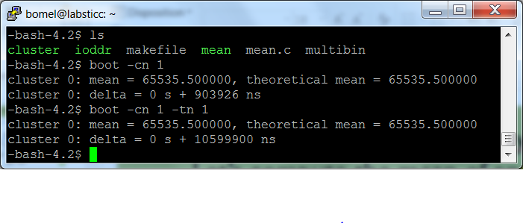
Let’s make a try Let’s compute the mean of an array with OpenMP
To execute the OpenMP application with 1 thread only : boot –cn 1 –tn 1
What is the new computation time ?
10.6 ms have been necessary with one thread !

Slide 25
Exercise 1 : what is the impact of the number of threads on the computing time ?
Now it is your turn !
Execute the same program with a varying number of theads (1, 2, …)
Draw the curve (x = number of threads, y = computing time)
Can you tell me what is the maximum number of threads for a cluster ?
Was it worth to parallelize ?

Slide 26
Exercise 1 : draw the curve (x = threads, y = computing time) with OpenMP
ms
1.2
1.1
1.0
.9
.8
.7
.6
.5
.4
.3
.2
.1
threads

Slide 27
Exercise 1 : I suggest you to take a few minutes to have a look to the OpenMP C code
#pragma omp parallel shared(array, mean)
{
#pragma omp for schedule(auto) private(thread)
for(thread = 0; thread < threads; thread++)
{
int i;
double sum, *base;
sum = 0.0;
base = array + (thread * thread_size);
for(i=0; i<thread_size; i++) sum += base[i];
mean[thread] = sum/((double)thread_size);
}
} // end of work
sum = 0.0;
for(i=0; i<threads; i++) sum += mean[i];
m = sum / ((double)threads);
tm = ((double)(ARRAY_SIZE-1))/2.0; // the final mean value
Parallel
part
Sequential part

Slide 28
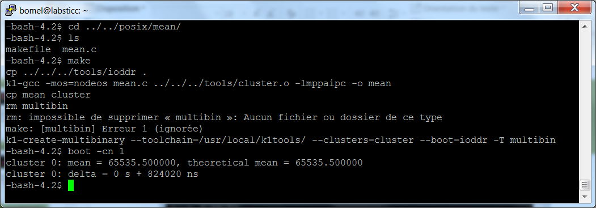
Exercise 2 : what is the impact of the number of threads on the computing time, with Posix ?
Now it is your turn !
Execute the same program with a varying number of theads (1, 2, …)
Draw the curve (x = number of threads, y = computing time)
Can you tell me what is the maximum number of threads for a cluster ?
Was it worth to parallelize ?
Which one OpenMP/Posix is the best ?

Slide 29
Exercise 2 : draw the curve (x = threads, y = computing time) with Pthreads
ms
1.2
1.1
1.0
.9
.8
.7
.6
.5
.4
.3
.2
.1
threads

Slide 30
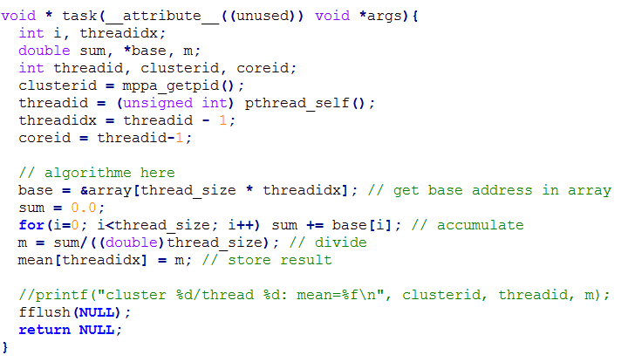
Exercise 2 : I suggest you take a few minutes to have a look to the OpenMP C code
Parallel
part
Sequential part

Slide 31
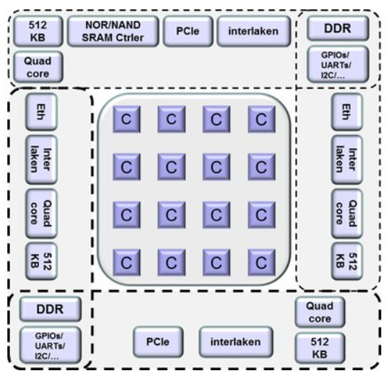
Development environment Booting the MPPA-256 at system level
The MPPA-256 is accessible via the PCI bus, inside the MPPA-developer box.
Phase 1: Booting the MPPA-256 means to load an executable file in the IODDR0 core.
PCI
Communication and synchronization are done through PCI (shared memory)

Slide 32
Development environment Booting the MPPA-256 at chip level
Phase 2: Booting the clusters from IODDR0.
Communication and synchronization are done through 2 NoCs:
DNoC "data NoC" and CNoC "control NoC"

Slide 33
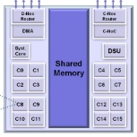
Development environment Booting the MPPA-256 at cluster level
Phase 3: the core 0, will start the required threads on other cores, within its cluster.
Communication and synchronization are done through a 2 MB shared memory.

Slide 34
Development environment Some tools, just for you
Because Kalray’s code and doc
is too complex for beginners
I’ve developped a reduced
version of only what you need
for your project.
tools
cluster_lib.c
cluster_lib.h
makefile
makefile.vars
mppa_256.h
params.c
params.h
ioddr.c
ioddr_lib.c
ioddr_lib.h
sync.c
sync.h
boot.c

Slide 35
Development environment Variables for compilers
You will compile all your C/C++ codes with GCC
BUT !
You will use different versions of GCC, depending on the target.
There is one gcc for the MPPA-developper (just a regular PC)
There is another GCC for the IODDR0
And another one for the clusters
All is coded once in the makefile* files, never modify them.
CC C compiler for PC
CPP C++ compiler for PC
K1CC C compiler for CLUSTERS (core codename is k1)
K1CPP C++ compiler for CLUSTERS
K1IOCC C compiler for IODDRs
K1IOCPP C++ compiler for IODDRs
makefile
makefile.vars

Slide 36
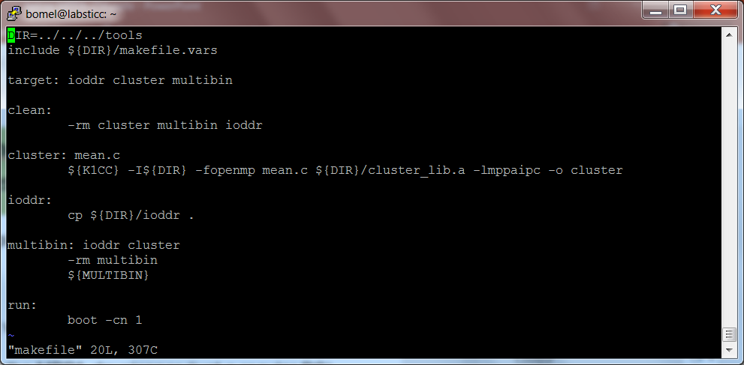
Development environment teacher/openmp/mean/makefile
Look at the use of K1CC

Slide 37
Development environment The build+boot path
MPPA "world"
PC "world"
ioddr.c
cluster.c
Suffixes conventions
for file names:
*.o = pc
*.io.o = ioddr
*.cluster.io = cluster
boot.c
K1IOCC
K1CC
CC
ioddr
cluster
create multibin
boot
multibin
(ioddr+cluster)
Phases 1+2+3

Slide 38
Development environment How to build or clean tools
makefile
makefile.vars
To remove all
To create all
To only create the system level boot
To only create the ioddr
To only create the cluster lib
make clean
make
make boot
make ioddr
make cluster_lib.a

Slide 39
Development environment User parameters: acces to argc and argv
params.c
params.h
As well as the boot program, the ioddr and the cluster
boot programs have acces to a copy of the argc + argv parameters.
#include "params.h"
int main(int argc, char *argv[]) { … }
We have prepared a set of parameters that will be used,
and you can also add your own parameters.
-m multibin
-i ioddr
-c cluster
-pci 0/1
-i iorank
-cn n
-tn t
-tb 0/1
-ti 0/1
name of the multibin file multibin
name of the ioddr file ioddr
name of the cluster file cluster
PCI Interface selection 0
ioddr rank 128
number of clusters to boot 16
number of threads to start 16
trace host boot 0
trace ioddr boot 0

Slide 40
Development environment User parameters: acces to argc and argv
params.c
params.h
#include "params.h"
int main(int argc, char *argv[])
{
params(argc, argv); // analyse parameters
int clusters = get_clusters();
int threads = get_threads();
char * str = get_param("-myparam");
int myparam = atoi(str); // ascii to integer
}
make
boot –cn 2 –tn 3 –myparam 12
Will build a "boot" program which will discover at runtime that
clusters = 2
threads = 3
myparam = 12

Slide 41
Development environment User parameters: acces to argc and argv
You don’t need to look in details to the following files.
But you may look at them to learn how to boot the MPPA-256.
A set of Kalray specific constants
The host boot program
The default ioddr boot program
Library of ioddr functions
Library of cluster functions
Library of sync. and comm. functions
mppa_256.h
boot.c
ioddr.c
ioddr_lib.c/h
cluster_lib.c/h
sync.c/h

Slide 42
Development environment Let’s look more closely to teacher/posix/mean
A makefile reusing our conventions
The only source file
makefile
mean.c
To remove all
To create all
make clean
make

Slide 43
Development environment Let’s look more closely to teacher/posix/mean
MPPA "world"
We make a copy of the ioddr boot program
We build a new cluster boot program
We reuse the boot program to boot the MPPA
All the examples are based on the same process
tools/ioddr
mean.c
cp
K1CC
ioddr
cluster
PC "world"
create multibin
boot
multibin
(ioddr+cluster)
Phases 1+2+3

Slide 44
To conclude about the "cluster-centric" world.
We suggest you to use a graphical editor like gedit.
For the ones who like vi, I’ve attached English and Spanich versions of vi’s quick ref card
Now you know all to be able to create your own cluster-based application !!!!
gedit mean.c &
vi mean.c

Slide 45
How to produce a chip-level application ?
This will include:
- communication between clusters and ioddrs
- synchronization
- creation of a custom ioddr boot program
Hopefully, all is available at teacher/chip-level

Slide 46
Development environment teacher/chip-level
A makefile reusing our conventions
The cluster source file
The specific ioddr source file
makefile
mean.c mean.h
ioddr.c
To remove all
To create all
make clean
make

Slide 47
Development environment Let’s look more closely to teacher/chip-level
MPPA "world"
We build a new ioddr boot program
We build a new cluster boot program
We reuse the boot program to boot the MPPA
The ioddr uses the tools/sync.c functions
ioddr.c
mean.c
K1IOCC
K1CC
ioddr
cluster
PC "world"
create multibin
boot
multibin
(ioddr+cluster)
Phases 1+2+3

Slide 48
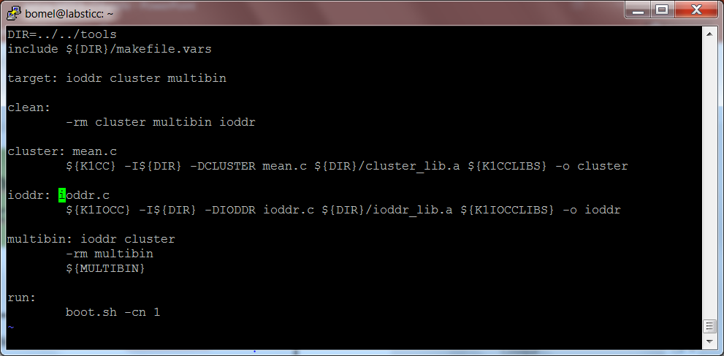
Development environment Let’s look more closely to chip-level
Look at the use of K1CC to create the cluster boot program
Look at the use of K1IOCC to create the ioddr boot program

Slide 49
Development environment Let’s look more closely to chip-level/ioddr.c
1/ We initialize the array mean to 0, before booting the clusters
2/ We initialize the ioddr library with the user parameters
3/ We initialize the synchronization library
4/ We initialize the communication library

Slide 50
Development environment Let’s look more closely to chip-level/ioddr.c
1/ We initialize the array mean to 0, before booting the clusters
2/ We initialize the ioddr library with the user parameters
3/ We initialize the synchronization library
4/ We initialize the communication library

Slide 51
Development environment Let’s look more closely to chip-level/ioddr.c
1/ We initialize the array mean to 0, before booting the clusters
2/ We initialize the ioddr library with the user parameters
3/ We initialize the synchronization library
4/ We initialize the communication library

Slide 52
Development environment Let’s look more closely to chip-level/ioddr.c
1/ We initialize the array mean to 0, before booting the clusters
2/ We initialize the ioddr library with the user parameters
3/ We initialize the synchronization library
4/ We initialize the communication library

Slide 53
Development environment Let’s look more closely to chip-level/ioddr.c
4/ We initialize the communication library
It means that the clusters will be able to write a data in the mean array.
means
0
0
0
0
There are clusters elements in the mean array
clusters is the value of the –cn user parameter

Slide 54
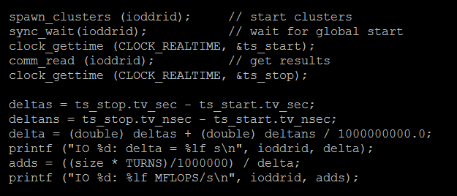
Development environment Let’s look more closely to chip-level/ioddr.c
The following is:
the start of all the clusters with spawn_clusters()
the wait of the boot of all clusters with sync_wait()
the read of the start time with clock_gettime()
the wait of the end of all the clusters with comm_read()
the read of the stop time with clock_gettime()
the computing of the global mean and computing duration

Slide 55
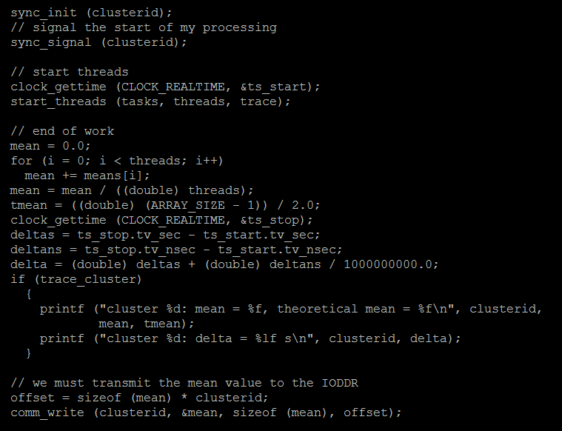
Development environment Let’s look more closely to chip-level/mean.c
The following contains for each cluster
the start signal with sync_signal()
The start of threads with start_threads()
The final write of the mean value with comm_write()

Slide 56
Development environment Let’s look more closely at the synchronization
host
ioddr
Host starts ioddr and waits for its termination
cluster-0
cluster-n
ioddr starts clusters
and waits for their termination
thread1
threadp
thread1
threadp
cluster starts threads
and waits for their termination
cluster starts threads
and waits for their termination
End of all the theads
End of all the theads
End of all the clusters
End of all the ioddr
End of the application

Slide 57
Development environment One last thing: sharing the access to the MPPA …
Because you are many groups and there is a single MPPA-256
There is a problem to access the MPPA-256 !
One group could start a computation, and before it is finished, another group may start another computation, reseting the MPPA-256 before the previous computation has finished. Imagine what will be the great pleasure of the first group …
To avoid this situation, we have used the very useful filelocking functionnality of Linux/UNIX (flock) to protect a given application from being reseted by another one before it ends.
flock has simply be used in the boot.sh shell script which does the following:
flock /home/accesscore/bin bootbin $*
bootbin is the real boot program. For more informations about flock, type:
man flock

Slide 58
Exercice 3: testing of the chip-level application
Now you can mix a varying number of clusters with a varying number of threads
and a varying array of values.
Let C be the number of clusters
Let T be the number of threads per cluster
Let S be the total size of the array
Try different combinations to extract the law of the aggregated computing power
Mflops = f(C, T, S) ????????
boot –cn C –tn T –size S
Remember that each cluster has 2MB of shared memory and the array is splitted
among all the clusters. Then, if a maximum size of 384K values is possible at
cluster-level than a size of 384*clusters K values is possible at chip-level.

Slide 59
Exercise 3 : draw the curve
MFLOPS
3500
3000
2000
1000
Threads
Clusters
Size ?
0

Slide 60
Mini-project: find the maximum and the minimum (with me)
Now you can mix a varying number of clusters with a varying number of threads
and a varying array of values. Your first mini-project will be to reuse the code of the chip-level and modify it to extract the maximum and minimum values from the array.
1/ You must initialize the array with random values
generate random numbers with rand_r().
Help with: man –s 3 rand
2/ You must scan all the arrays to extract the min/max values
3/ At cluster level you must keep the min(max) of all the min(max) returned by the threads
4/ At chip level you must keep the min(max) of all the min(max) returned by the clusters
5/ Finally you print the min/max values

Slide 61
Your project (without me)
From now, you are skilled enough and able write your own MPPA programs.
Your project is the following: instead of computing the min/max values of an array,
you will estimate the PI number.
Imagine we are playing darts and randomly throw darts to a circular target.

Slide 62
Your project: estimate PI
Let R be the circle’s radius
Let S be the area of the surronding square
Let C be the area of the circle
S = ${(2R)}^{2}$
C = $πR^{2}$
If R = 1, then $π=4C/S$
If we replace S by the total number of darts
and replace C by the number of darts in the circle
we have got an estimation of PI.
The more darts we throw,
the better the accuracy of PI !
With the picture on the left (only 20 darts)
$$π=\frac{4 . 16}{20}=3.200$$

Slide 63
Your project: estimate PI
Design, and code an application at chip-level, that will estimate PI.
You can generate random numbers with rand_r().
Help with: man –s 3 rand
Draw the curve of the law, expressing the quality of the estimation (error from real PI) from the number of clusters, threads and darts used in the computation.
double real_pi = acos(-1.0);
$$π ?$$

Slide 64
Estimate PI: a possible software architecture
Ioddr 0
PI
The ioddr
computes the mean value
of the cluster-estimates of PI
Cluster 0
PI[0]
Cluster 15
PI[15]
Each cluster
computes the mean value
of the thread-estimates of PI
Thread 0
PI[0]
Thread 15
PI[15]
Thread 0
PI[0]
Thread 15
PI[15]
Threads throw darts
and estimate PI
with the formulae

Slide 65
That’s all for today
Many thanks for your kind attention !
Pierre Bomel

Slide 66
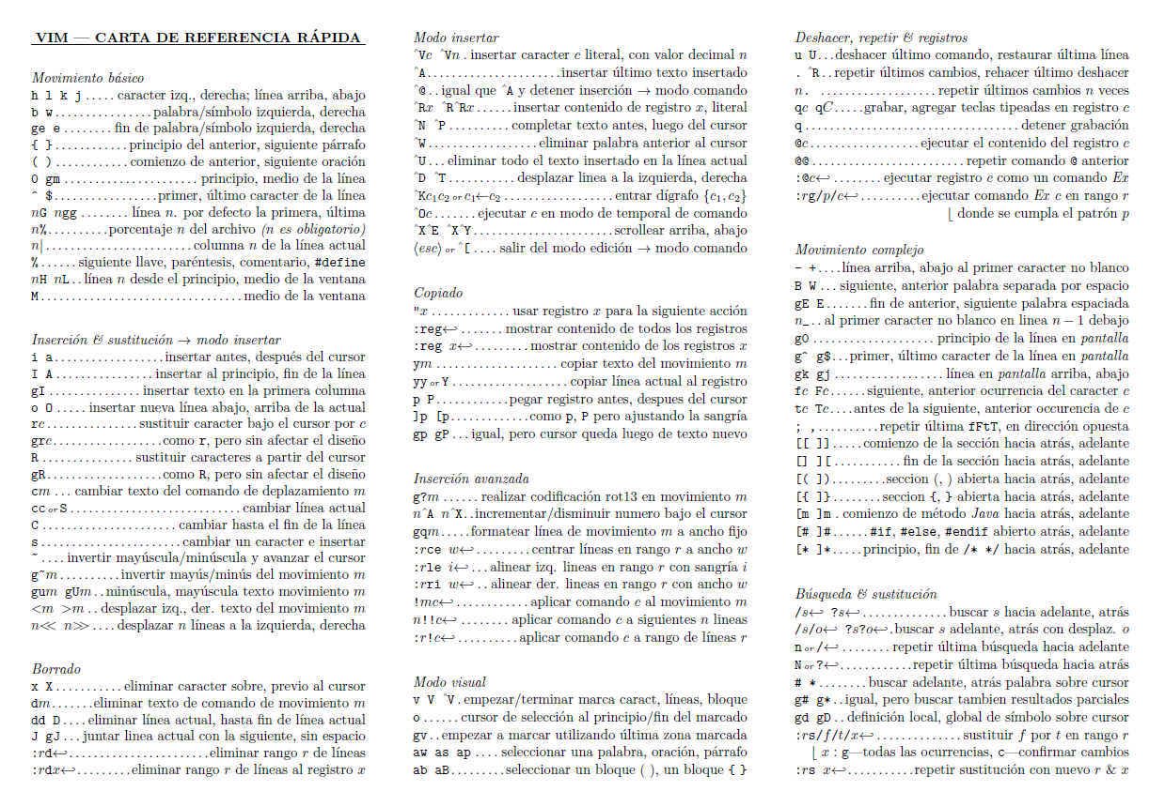
vi/vim ref card (Spanish)

Slide 67
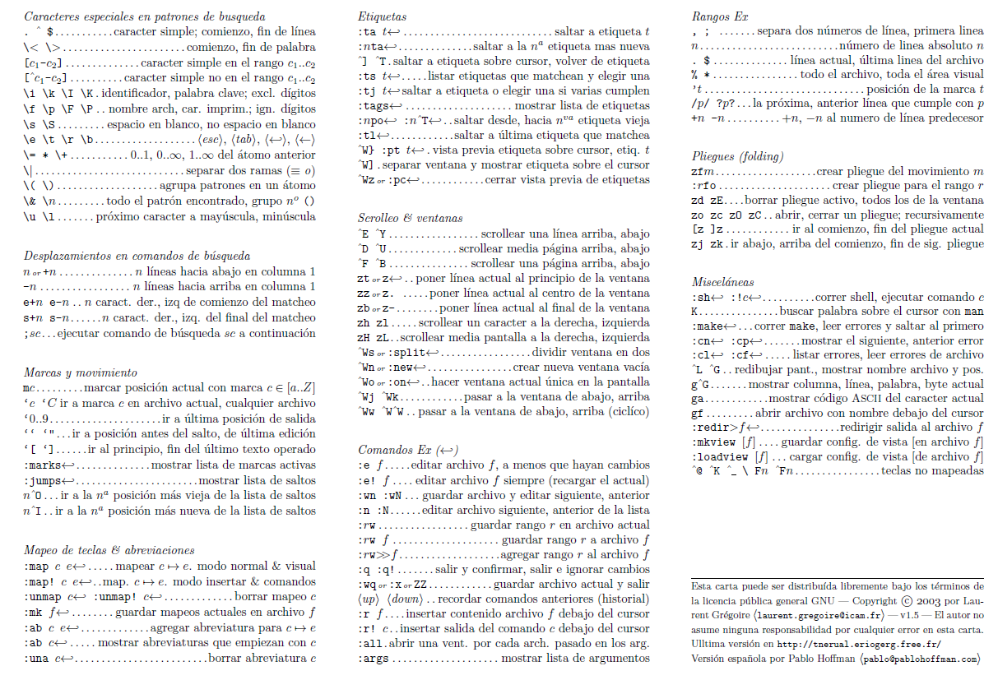
vi/vim ref card (Spanish)

Slide 68
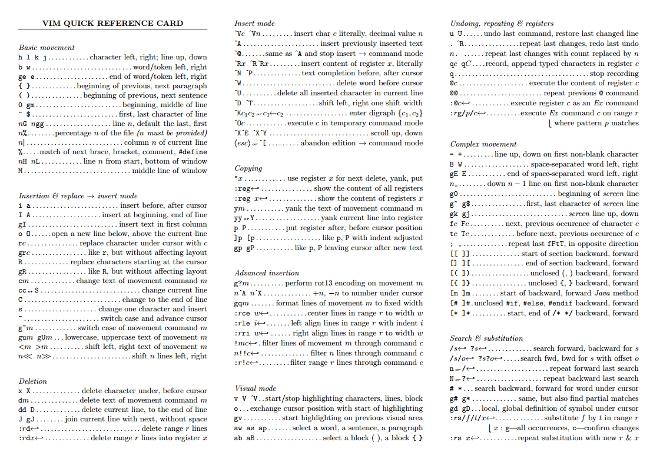
vi/vim ref card (English)

Slide 69
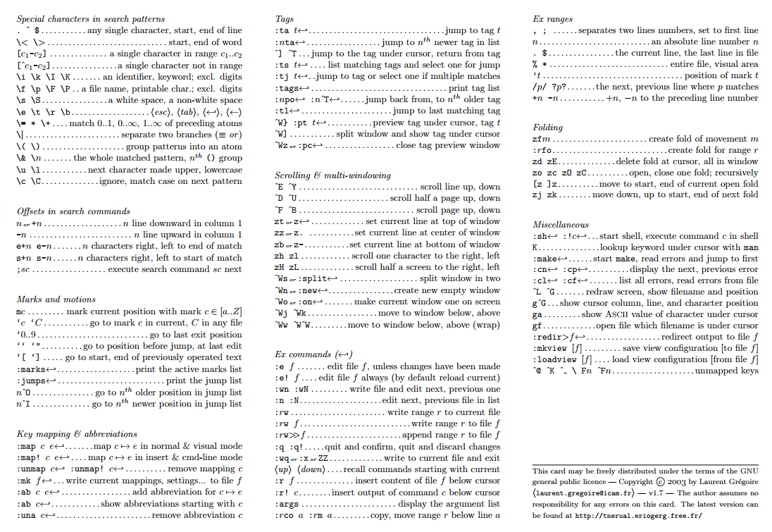
vi/vim ref card (English)

