Slide 1
Many-core programming, a practical approach.
COMPAS conference
July 5-8 2016
Pierre Bomel
Université de Bretagne Sud
Lab-STICC
Lorient, France
http://www.univ-ubs.fr/
http://www.lab-sticc.fr/

Slide 2
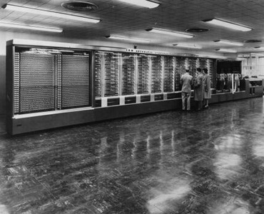
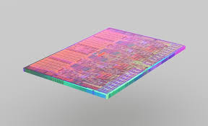
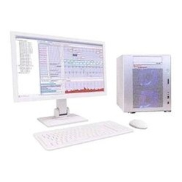
Plan
1^{rst} day
1^{rst} hour: from the first computers to multithreading
2nd hour: software paradigms for many-cores
3rd hour: Kalray’s MPPA-256 and project presentation
2nd day
Your project with remote Kalray machines at UBS
OpenCL
OpenMP
MPI
Posix

Slide 3
Software paradigms for many-cores (an introduction to)
Plan of the 2nd part
Standards for parallel programming
Thread programming (and shared memory)
OpenMP
Posix Threads
Heterogeneous computers, GP-GPUs
OpenCL
Communication/synchronization
MPI
Yes, it is a wide and complex world of tools and standards !!!
These slides do not (and can’t, in a so short time) intend to be exhaustive.
We shall present and rapidly compare these paradigms to give you enough knowledge to (safely) choose design tools for your future parallel applications.

Slide 4
Available standards for parallel programming models.
Shared memory: Posix Threads, OpenMP
Distributed memory, message passing: MPI
Data parallel: OpenCL
(CUDA is avoided, because this is not a standard, it is NVIDIA’s proprietary)

Slide 5
OpenMP/Posix/OpenCL/MPI C/C++ headers
OpenMP #include <omp.h>
Posix threads #include <pthread.h>
OpenCL #include <CL/opencl.h>
MPI #include <mpi.h>

Slide 6
OpenMP (late 1990s)
Scope:
The OpenMP API covers only user-directed parallelization, wherein the programmer explicitely specifies the actions to be taken by the compiler and runtime system in order to execute the program in parallel. OpenMP-compliant implementations are not required to check for data dependencies, data conflicts, race conditions or deadlocks, any of which may occur in OpenMP programs.
Refs:
http:// http://openmp.org/wp/openmp-specifications/ standards
https://computing.llnl.gov/tutorials/openMP/ tutorials

Slide 7
OpenMP
Execution model is "fork-join"
Teams of threads, with a unique master thread
Worksharing
Task
Memory model
A thread as a private memory (registers, stack) and a copy of a globally shared memory by the group of threads it belongs to.

Slide 8
OpenMP fork-join
Team of // threads
Master thread switches to a new task
Master thread
executes a task
Master thread resumes
its previous task
…
FORK
JOIN
Time
Start of new team
Barrier at end of all threads
of the team

Slide 9
OpenMP memory model
Globally shared memory
Cache
Cache
Cache
Cache
Cache
thread
thread
thread
thread
…
thread
Private
Stack
regs
Private
Stack
regs
Private
Stack
regs
Private
Stack
regs
Private
Stack
regs

Slide 10
OpenMP (but not only) Can different executions produce different results ?
Unfortunately YES …
It is due to the ordering of the floating operations done by the threads and the unavoidable roundings occuring at each step in the FPUs. These two computations may not give the same result (a very small diff. may appear)
a
b
a
b
c
d
x
c
x
x
x
d
x
e
x
e
x
(((a*b)*c)*d)*e
x
((a*b)*(c*d))*e

Slide 11
OpenMP – the minimum you must know directives
#pragma omp parallel // parallel region
#pragma omp [parallel] for // worksharing
#pragma omp [parallel] sections
#pragma omp [parallel] single
#pragma omp flush // cache coherency
#pragma omp task // tasks
#pragma omp master // synchronisation
#pragma omp critical
#pragma omp barrier
#pragma omp taskwait
#pragma omp atomic

Slide 12
OpenMP #pragma omp parallel
omp
sequential
A();
#pragma omp parallel num_threads(4)
{
B();
}
C();
A();
B(); B(); B(); B();
C();
B
B
A
C
B
B

Slide 13
OpenMP #pragma omp parallel for
sequential
omp
int i;
A();
for(i=0; i < 4; i++) B();
C();
int i;
A();
#pragma omp parallel for
for(i=0; i < 4; i++) B();
C();
B
B
A
C
B
B
Loop variables (i) are private, by default, external one are shared

Slide 14
OpenMP #pragma omp parallel sections
omp
A();
#pragma omp parallel sections
{
#pragma omp section
{ B1(); }
#pragma omp section
{ B2(); }
#pragma omp section
{ B3(); }
#pragma omp section
{ B4(); }
}
C();
sequential
A();
B1();
B2();
B3();
B4();
C();
B1
B2
A
C
B3
B4

Slide 15
OpenMP #pragma omp parallel single
int i;
A();
#pragma omp parallel num_threads(2)
{
B();
#pragma omp parallel single
{ C(); }
D();
}
E();
B
D
A
C
E
B
D
FORK
JOIN

Slide 16
OpenMP private() and shared() clauses
int i; int x = 0;
#define THREADS 4
#define TURNS 1000
#pragma omp parallel for private(i) shared(x)
for(i=0; i < THREADS; i++) {
int j; for(j=0; j<TURNS; j++)
x = x + 1;
}
printf("x=%d\n", x);
What is the value of x ?
4000 ? No
1000 ? Yes, but why ?

Slide 17
OpenMP private() and shared() clauses
Unique & shared variable
Local copies in the caches
x= 0
FORK
x’= x
x’= x
x’= x
x’= x
x’= x’+1
x’= x’+1
x’= x’+1
x’= x’+1
…
x’= x’+1
x’= x’+1
x’= x’+1
x’= x’+1
…
x’= x’+1
x’= x’+1
x’= x’+1
x’= x’+1
…
x’= x’+1
x’= x’+1
x’= x’+1
x’= x’+1
…
JOIN
x’= 1000 (and x still equals 0, without cache flush)
Because each thread works on its local copy of a shared variable !
time

Slide 18
OpenMP #pragma omp flush
#pragma omp parallel for private(i) shared(x)
for(i=0; i < THREADS; i++) {
int j; for(j=0; j<TURNS; j++)
{
#pragma omp flush(x)
x = x + 1;
#pragma omp flush(x)
}
}
printf("x=%d\n", x);
What is the value of x ?
4000 ? Possible
1000 ? Possible
1000 < x < 4000 ? Possible, but why ?

Slide 19
OpenMP #pragma omp flush
1rst flush forces a read, 2nd flush forces a write
x = 0
FORK
x’=x; x’= x’+1; x=x’
x’=x; x’= x’+1; x=x’
x’=x; x’= x’+1; x=x’
x’=x; x’= x’+1; x=x’
…
x’=x; x’= x’+1; x=x’
x’=x; x’= x’+1; x=x’
x’=x; x’= x’+1; x=x’
x’=x; x’= x’+1; x=x’
…
…
…
x = 1000, x = 4000, 1000 < x < 4000 are possible
JOIN
Because there is a race condition in (x = x + 1) !
A variable number of written values can be lost.
We need a critical section.
time

Slide 20
OpenMP #pragma omp flush
x=0
FORK
…
x’=x; (10)
x’=x’+1; (11)
x=x’ (11)
…
…
x’=x; (10)
x’=x’+1; (11)
x=x’ (11)
…
…
…
JOIN
Here is the race condition !
The value written by the left thread has been lost.
time

Slide 21
OpenMP #pragma omp critical
#pragma omp parallel for private(i) shared(x)
for(i=0; i < THREADS; i++) {
int j; for(j=0; j<TURNS; j++)
{
#pragma omp critical
x = x + 1;
}
}
printf("x=%d\n", x);
What is the value of x ?
4000 ? Yes, always now !!!!

Slide 22
OpenMP #pragma omp atomic
#pragma omp parallel for private(i) shared(x)
for(i=0; i < THREADS; i++) {
int j; for(j=0; j<TURNS; j++)
{
#pragma omp atomic update
x = x + 1;
}
}
printf("x=%d\n", x);
The same result can be obtained with the classical data-base management system’s (DBMS) concept of transaction’s atomicity.
What is the value of x ?
4000 ? Yes, always !!!!

Slide 23
OpenMP atomic vs critical
#pragma omp parallel for private(i) shared(x)
for(i=0; i < 2; i++)
int j; for(j=0; j<1000; j++)
{
#pragma omp atomic update
x = x + 1;
#pragma omp atomic update
y = y + 1;
}
What is the difference between critical and atomic ?
All critical regions are exclusive, only one can be executed at a given time.
It is extremely constraining.
Atomic only implies the atomicity of a given computation. Several atomic computations can execute in parallel, but not several instances of the same one.

Slide 24
OpenMP atomic vs critical
Different atomic computations can overlap in time
while a critical would serialize them all.
x=0
FORK
x’=x; x’= x’+1; x=x’
y’=y; y’= y’+1; y=y’
x’=x; x’= x’+1; x=x’
…
y’=y; y’= y’+1; y=y’
x’=x; x’= x’+1; x=x’
y’=y; y’= y’+1; y=y’
…
JOIN
time

Slide 25
OpenMP – an explicit fork-join #pragma omp task/taskwait
#pragma omp parallel //create a parallel region
{
#pragma omp single //disable automatic parallelization
{
A();
for(i=0; i < TASKS; i++) {
#pragma omp task //explicit fork of threads
{ B(); }
}
#pragma omp taskwait //explicit wait for all threads
C();
}
}
task
taskwait
B
A
C
B

Slide 26
OpenMP #pragma omp barrier
A();
#pragma omp parallel num_threads(2)
{
B();
#pragma omp barrier
C();
}
D();
FORK
Barrier
JOIN
B
C
A
D
B
C

Slide 27
OpenMP #pragma omp master
A();
#pragma omp parallel num_threads(2)
{
#pragma omp master
{ B(); }
C();
}
D();
FORK
JOIN
B
C
A
D
C

Slide 28
OpenMP How to write a code whose behaviour depends on the thread’s ID ?
int T[16000]
T[0-999] T[1000-1999] T[2000-2999] T[3000-3999] … T[15000-15999]
Cache
Cache
Cache
Cache
Cache
Thread
1
Thread
2
Thread
3
Thread
4
…
Thread
16
Private
Stack
regs
Private
Stack
regs
Private
Stack
regs
Private
Stack
regs
Private
Stack
regs
Each thread (numbered from 0 to N-1) will compute a range of values for T.

Slide 29
OpenMP How to write a code whose behaviour depends on the thread’s ID ?
#define THREADS 16
#define SLOTS_PER_THREAD 1000
#define SIZE (THREADS * SLOTS_PER_THREAD)
int T[SIZE];
#pragma omp parallel num_threads(THREADS)
{
int thread = omp_get_thread_num();
int *base = T + (thread * SLOTS_PER_THREAD);
int i; for(i=0; i<SLOTS_PER_THREAD; i++)
base[i] = f();
}
Each thread (numbered from 0 to N-1) will compute a range of values for T.

Slide 30
OpenMP some usefull tools
omp_get_num_threads() returns the number of threads in the team
omp_get_thread_num() returns the unique number of the thread in the team
omp_in_parallel() true when enclosed in a parallel region
omp_get_thread_limit() returns the maximum number of available threads
omp_init_lock() locks for synchronization
omp_destroy_lock()
omp_set_lock()
omp_unset_lock()
omp_test_lock()
double omp_get_wtime() get "wall time" in seconds

Slide 31
OpenMP Conclusion
Uses annotations to express parallelism.
Stable, very common.
Relies on a shared memory concept.
Danger is about data consistency (caches flushes needed and user-driven)
Danger is also about race conditions.
Very often, is build on top of Posix theads (next section).

Slide 32
POSIX (1980s)
Scope:
In shared memory multiprocessor architectures, threads can be used to implement parallelism. Historically, hardware vendors have implemented their own proprietary versions of threads, making portability a concern for software developers. For UNIX systems, a standardized C language threads programming interface has been specified by the IEEE POSIX 1003.1c standard. Implementations that adhere to this standard are referred to as POSIX threads.
Refs:
https://standards.ieee.org/develop/wg/POSIX.html standards
https://standards.ieee.org/findstds/standard/1003.1-2008.html
https://computing.llnl.gov/tutorials/pthreads tutorials
In the following slides, we have reused (and commented) some pictures and texts from the LLNL tutorials.
Please, read them to get full and updated informations about pthreads.

Slide 33
POSIX
POSIX = Portable Operating System Interface, X is for UniX/LinuX
standards to write portable software between Unix systems
POSIX 1 base standard for C programming, multitasking, and processes
(IEEE Std 1003.1-1988)
POSIX 1.b real time extensions, shared memory, synchronisation,
communication by messages
(IEEE Std 1003.1b-1993)
POSIX 1.c lightweight processes, threads
(IEEE Std 1003.1c-1995)

Slide 34
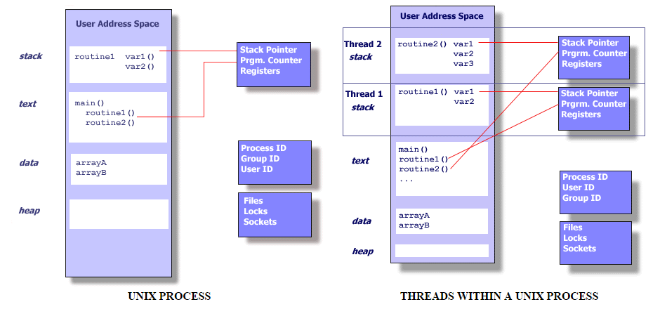
POSIX 1.c threads

Slide 35
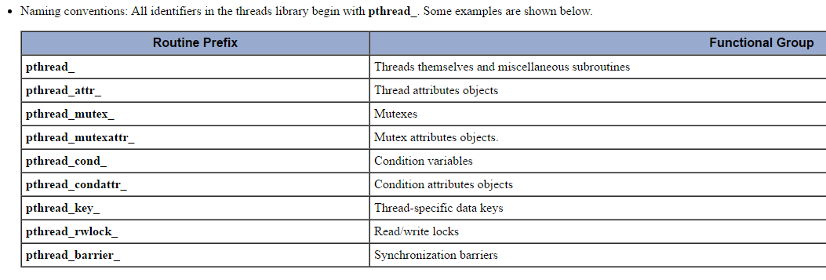
POSIX 1.c API
Like with OpenMP we find here:
thread management (creation, deletion, fork, join, …)
and synchronization (mutexes, locks, barriers, …)

Slide 36
Pthreads – the minimum you must know
pthread_create() // thread management
pthread_exit()
pthread_join()
pthread_mutex_lock() // mutexes
pthread_mutex_unlock()
pthread_barrier_init() // barrier
pthread_barrier_wait()
pthread_self() // thread’s ID

Slide 37
POSIX 1.c - fork-join model explicit coding of threads creation and parallelism.
#define THREADS
pthread_t t[THREADS]; // POSIX specific
void * job(void * addr)
{
printf("thread %d running\n", (int)addr);
pthread_exit(addr);
}
int main()
{
int i, stat;
for(i=0; i<THREADS; i++) // FORK
pthread_create(&t[i], NULL, job, i);
for(i=0; i<THREADS; i++) // JOIN
pthread_join(t[i], &stat);
return 0;
}

Slide 38
POSIX 1.c - fork-join model explicit coding of threads creation and parallelism.
#define THREADS 4
pthread_t t[THREADS]; // POSIX specific
Void * job(void * addr)
{
printf("thread %d running\n", (int)addr);
pthread_exit(addr);
}
int main()
{
int i, stat;
for(i=0; i<THREADS; i++)
pthread_create(&t[i], NULL, job, i);
for(i=0; i<THREADS; i++)
pthread_join(t[i], &stat);
return 0;
}
Thread end
Thread creation
FORK is user written
JOIN is user written
Thread wait

Slide 39
POSIX 1.c Access to shared data
Like with OpenMP, we have the same problem to access shared data:
Cache flushing is required:
for the producer (writer) to share the new value
for the consumers (readers) to have access to the last written value
pthread* do cache flushes, but there is NO cache flushing function
Race conditions
Explicit synchronization with mutexes, spinlocks, barriers …
is required !

Slide 40
POSIX 1.c critical section
Posix
pthread_mutex_t mtx;
pthread_mutex_init(&mtx, NULL);
pthread_mutex_lock(&mtx);
x = x + 1;
pthread_mutex_unlock(&mtx);
OpenMP
#pragma omp critical
{
#pragma omp flush(x)
x = x + 1;
#pragma omp flush(x)
}
It works because all pthread*() imply an automatic cache flush().

Slide 41
POSIX 1.c barrier
Posix
pthread_barrier_t bar;
pthread_barrier_init(&bar,NULL,threads);
pthread_barrier_wait(&bar);
OpenMP
#pragma omp barrier

Slide 42
POSIX 1.c How to write a code whose behaviour depends on the thread’s ID ?
#define THREADS 16
#define SLOTS_PER_THREAD 1000
#define SIZE (THREADS * SLOTS_PER_THREAD)
int T[SIZE];
void *job(void *addr)
{
pthread_t thread = pthread_self();
int *base = T + thread * SLOTS_PER_THREAD;
int i; for(i=0; i<SLOTS_PER_THREAD; i++)
base[i] = f();
}
Each thread (numbered from 0 to N-1) will compute a range of values for T.

Slide 43
Posix Conclusion
All parallelism is explicit and under user’s will.
Stable, very common.
Relies on a shared memory concept.
Danger is about data consistency (caches flushes needed and user-driven)
Danger is also about race conditions.

Slide 44
OpenCL (initiated by Apple, 2008)
Scope:
The open standard for parallel programming of heterogeneous systems. OpenCL™ (Open Computing Language) is the open, royalty-free standard for cross-platform, parallel programming of diverse processors found in personal computers, servers, mobile devices and embedded platforms. OpenCL greatly improves the speed and responsiveness of a wide spectrum of applications in numerous market categories from gaming and entertainment to scientific and medical software.
Refs:
https://www.khronos.org/opencl/ standards
https://www.khronos.org/opencl/resources tutorials

Slide 45
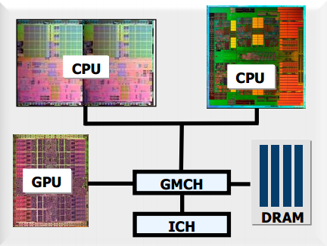
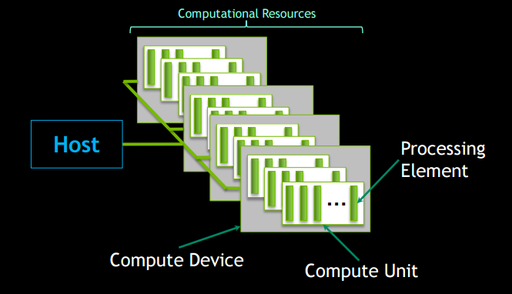
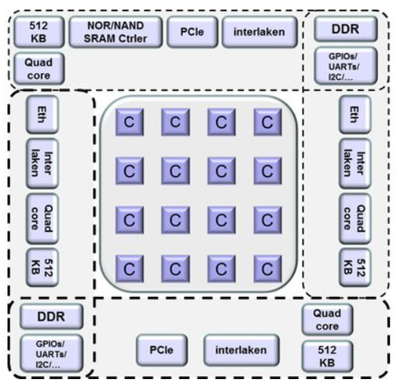
OpenCL Heterogeneous computers (NVIDIA, ATI, Kalray)
OpenCL’s platform model.
Dedicated to
hererogeneous computers.
PCI
PC
MPPA-256
http://www.cc.gatech.edu/~vetter/keeneland/tutorial-2011-04-14/06-intro_to_opencl.pdf

Slide 46
OpenCL Platform model
host
*
Data are here
devices
*
units
Threads are here
*
processing elements
2 difficulties:
- Move data from host to PE forth and back
- Target various heterogeneous computers with the same code

Slide 47
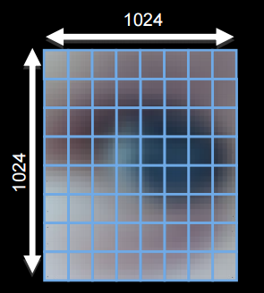
OpenCL = data parallelism Data is seen as a N-dimensions computation domain
Ex: Image = 2D, Say 1024x1024
Objective is to map computing ressources to points of the computation domain.
The computation ressource is programmed with a kernel.
kernel
A computing kernel
is mapped to all work items
A work group
A work item

Slide 48
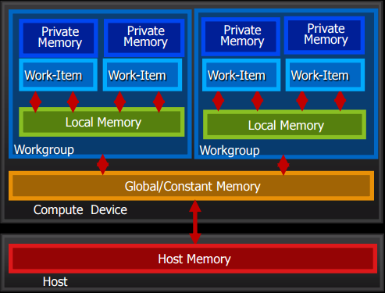
OpenCL = data parallelism Memory model
Move data from host to PE
forth and back.
Memory management is explicit !!!

Slide 49
OpenCL = data parallelism Synchronization + shared memory
Work items belonging to different groups cannot synchronize and share memory.
kernel
Work items within a work group can synchronize and share memory.

Slide 50
OpenCL Computing kernel
OpenMP
Posix
#define SIZE (1024*1024)
#define THREADS SIZE
int T[SIZE];
#pragma omp parallel num_threads(THREADS)
{
int id = omp_get_thread_num();
int i = fromid2index(id);
T[i] = f();
}
#define SIZE (1024*1024)
#define THREADS SIZE
int T[SIZE];
void *job(void *addr)
{
pthread_t id = pthread_self();
int i = fromid2index(id);
T[i] = f();
}
#define SIZE (1024*1024)
#define THREADS SIZE
int T[SIZE];
// a computing kernel could be the following
void __kernel(__global int *t)
{
int id = get_global_id();
int i = fromid2index(id); // i = id
T[i] = f();
}
OpenCL

Slide 51
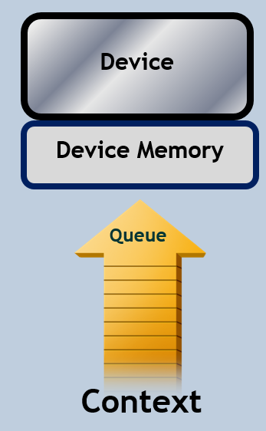
OpenCL Context & command queues
Context is the description of the heterogeneous computer
that has been discovered at runtime.
The host sends commands to the device(s) through
command queues.
Commands can be:
kernel execution
synchronization
explicit data movements

Slide 52
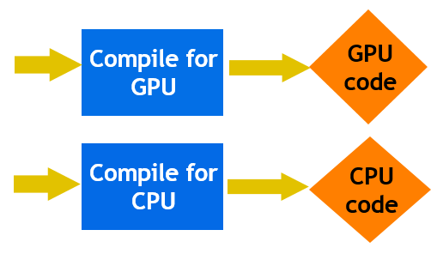
OpenCL Runtime compilation
OpenCL has the capability
of runtime compilation.
Because the same code can
target various processing elements.
Kernels are represented by
strings, given at runtime to compilers, to produce executable code of kernels.
5 simple steps in a basic host program:
Define the platform … platform = devices+context+queues
Create and Build the program (dynamic library for kernels)
Setup memory objects
Define the kernel (attach arguments to kernel functions)
Submit commands … transfer memory objects and execute kernels

Slide 53
OpenCL - an example discovery of the heterogeneous computer’s structure
#include <CL/opencl.h>
int main()
{
cl_int err;
cl_platform_id pltf;
cl_device_id dev;
cl_context ctx;
cl_command_queue queue;
cl_program prog;
cl_kernel kern;
err = clGetPlatformIDs(1, &pltf, NULL);
if (err) { ... } // error case
err = clGetDeviceIDs(pltf, CL_DEVICE_TYPE_ACCELERATOR, 1, &dev, NULL);
if (err) { ... } // error case
ctx = clCreateContext(0, 1, &dev, NULL, NULL, &err);
if (err) { ... } // error case

Slide 54
OpenCL - an example creation of the kernel code from a string
char *kernelsrc = // THE CODE !
"#include <stdio.h> \n" \ // #include <stdio.h>
"__task_kernel void task() { \n" \ // __task_kernel void task() {
" printf(\"hello world\\n\"); \n" \ // printf("hello world\n");
"}; \n" // }
;
prog = clCreateProgramWithSource(ctx, 1, &kernelsrc, NULL, &err);
if (err) { ... } // error case
kern = clCreateKernel(prog, "task", &err);
if (err) { ... } // error case
runtime compilation

Slide 55
OpenCL - an example execution and termination
queue = clCreateCommandQueue(ctx, dev, 0, &err);
if (err) { ... } // error case
err = clEnqueueTask(queue, kern, 0, NULL, NULL);
if (err) { ... } // error case
…
clFinish(queue);
clReleaseProgram(prog);
clReleaseCommandQueue(queue);
clReleaseContext(ctx);
return 0; // end of main()
}
execution

Slide 56
OpenCL Conclusion
May seem much more complex at first sight.
Targets multi-dimensional (2D-3D) and regular data (data parallelism).
But !
Targets execution of the same code (write once, execute on all platforms)
on all heterogenous computers: there is a need for a discovery phase to
dynamically adapt the software behaviour to the underlying hardware resources.
At work group level, parallel concepts are the same:
synchronization
+ data sharing
Computing granularity is smaller with OpenCL than with OpenMP and Pthreads.
Why ? It initially targeted GPUs (NVIDIA, ATI) with 100-1000ths of Pes.
Now also targets AMD’s Opteron and Intel’s Xeon-Phi many-cores.

Slide 57
MPI (1980s)
Scope:
The Message Passing Interface Standard (MPI) is a message passing library standard based on the consensus of the MPI Forum, which has over 40 participating organizations, including vendors, researchers, software library developers, and users. The goal of the Message Passing Interface is to establish a portable, efficient, and flexible standard for message passing that will be widely used for writing message passing programs. As such, MPI is the first standardized, vendor independent, message passing library. The advantages of developing message passing software using MPI closely match the design goals of portability, efficiency, and flexibility. MPI is not an IEEE or ISO standard, but has in fact, become the "industry standard" for writing message passing programs on HPC platforms.
Refs:
https://www.open-mpi.org/ standards
https://computing.llnl.gov/tutorials/mpi/ tutorials

Slide 58
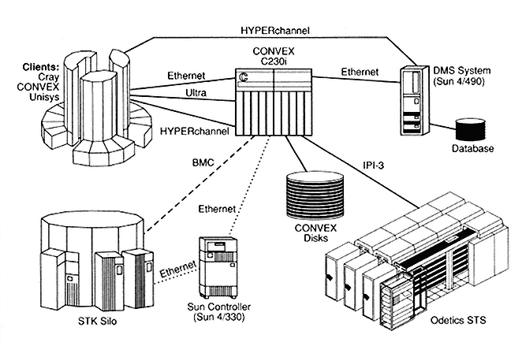
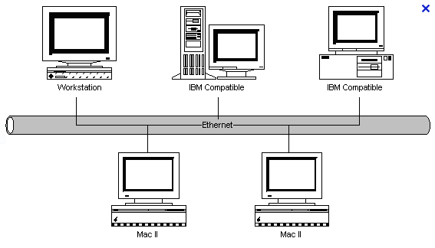
MPI
LAN
HPC
MPI is dedicated to interprocess communications (IPC). It targets multi-process (potentially multithreaded) systems with a distributed memory and connected via (at least) one communication network (parallel/super computers, heterogeneous computers, clusters of computers, …).
IPC = synchronization and movements of data from an address space to another.
Because MPI targets multi chips systems (and these lectures are willingly restricted to single-chips) we will present extremely shortly MPI.

Slide 59
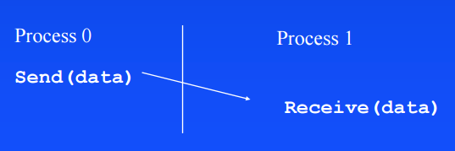
MPI
The message-passing approach makes the exchange of data cooperative.
Data is explicitly sent by one process and received by another.
An advantage is that any change in the receiving process’s memory is made with the receiver’s explicit participation. There are no data coherency (cache flushes) problems.
Communication and synchronization are combined.
No shared memory.

Slide 60
MPI – the minimum you must know
MPI_Send() // blocking communications
MPI_Recv()
MPI_Isend() // non-blocking comms
MPI_Irecv() // need an explicit wait
MPI_Waitany()
MPI_Waitall()
MPI_Waitsome()
MPI_Bcast() // collective comms
MPI_Scater()
MPI_Gather()
MPI_Reduce()
MPI_Barrier() // system-wide barrier
MPI_Comm_size() // number of processes
MPI_Comm_rank() // process’ ID
MPI_Wtime() // wall time

Slide 61
MPI blocking communications
Process 1
Process 2
A();
MPI_Send(to p2);
B();
MPI_Recv(from p2);
C();
AA();
MPI_Recv(from p1);
BB();
MPI_Send(to p1);
CC();
A
B
C
run
data
data
wait
AA
BB
CC

Slide 62
MPI non-blocking communications
Process 1
Process 2
A();
MPI_Isend(to p2);
B();
MPI_Irecv(from p2);
C();
MPI_Waitall();
D();
AA();
MPI_Isend(to p1);
BB();
MPI_Irecv(from p1);
CC();
MPI_Waitall();
DD();
A
B
C
D
run
data
data
wait
AA
BB
CC
DD

Slide 63
MPI collective communications
Master 1
Slaves 2-3-4
A();
MPI_Bcast(to all slaves);
B();
MPI_Barrier();
C();
AA();
MPI_Recv(from master);
BB();
MPI_Barrier();
CC();
A
B
C
run
data
wait
AA
BB
CC
AA
BB
CC
AA
BB
CC

Slide 64
MPI How to write a code whose behaviour depends on the process’ ID ?
#define THREADS 16
#define SLOTS_PER_THREAD 1000
#define SIZE (THREADS * SLOTS_PER_THREAD)
int T[SIZE];
void program()
{
int thread = MPI_comm_rank();
if (thread == 0) {
MPI_Scater(to all slaves);
MPI_Gather(from all slaves);
} else {
MPI_Recv(my part of T, from master);
int *base = T + thread * SLOTS_PER_THREAD;
int i; for(i=0; i<SLOTS_PER_THREAD; i++)
base[i] = f();
MPI_Send(my part of T, to master);
}
}

Slide 65
MPI Conclusion
MPI is not needed for multithreading but, as soon as the system becomes more complex, the shared memory concept does not scale very well (it serializes al the R/W the memory accesses) and a distributed memory + a communication network become necessary.
MPI is the de-facto programming standard used from clusters of PCs to HPC super-computers.
Kalray’s MPPA-256 contains both concepts on a single chip:
- shared memory at cluster level
- distributed memory at chip level
Unfortunately, MPI is not available at chip level. We’ll have to use a proprietary API to communicate between clusters.

Slide 66
Conclusion
We have presented the following parallel programming paradigms.
Parallel programming concepts
multithreading
multiprocessing
data parallel
Cache issues for data consistency
no data movements
No cache
data movements
Explicit sync + comm, no cache issues
Shared memory
Heterogeneous
GP-GPU like
Distributed memory
Annotated
All explicit
Posix
threads

Slide 67
A few more, last words
To all of you, many thanks for your kind attention !
Pierre Bomel

